Slide 1

Capstone project presentation
Travel with Locals

Slide 2
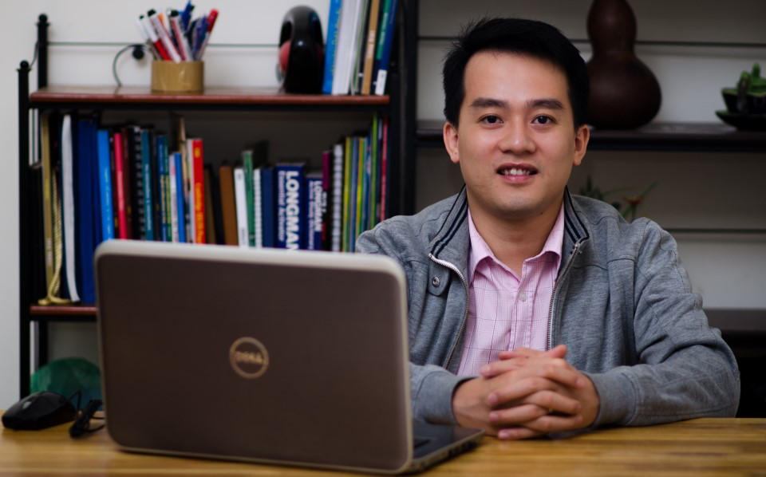
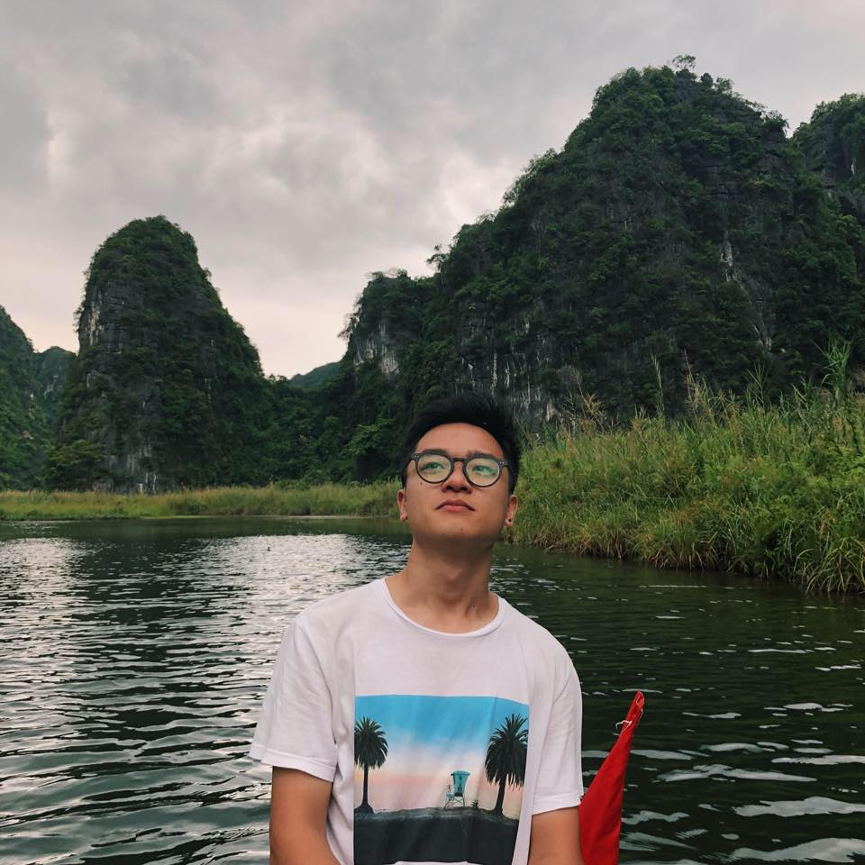
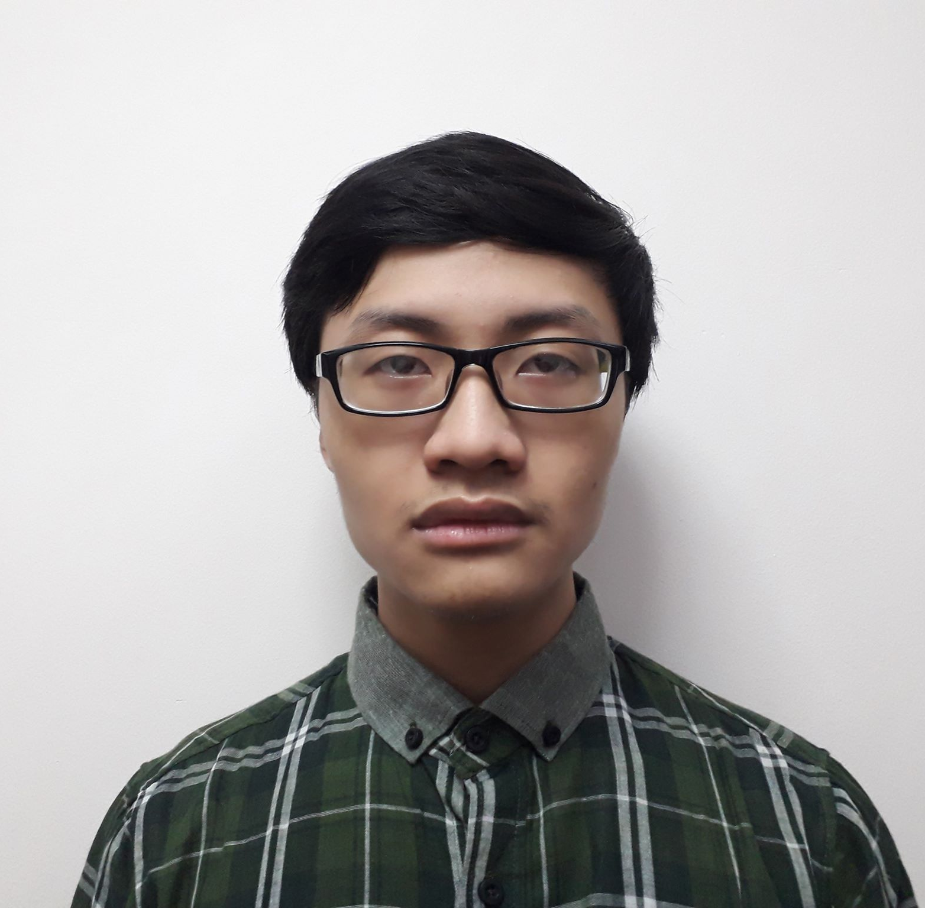
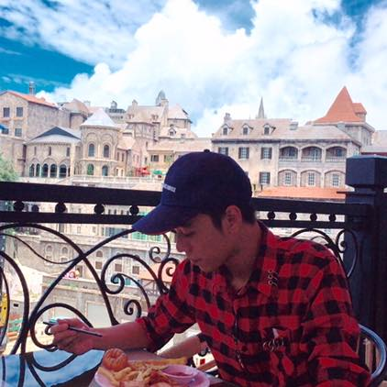
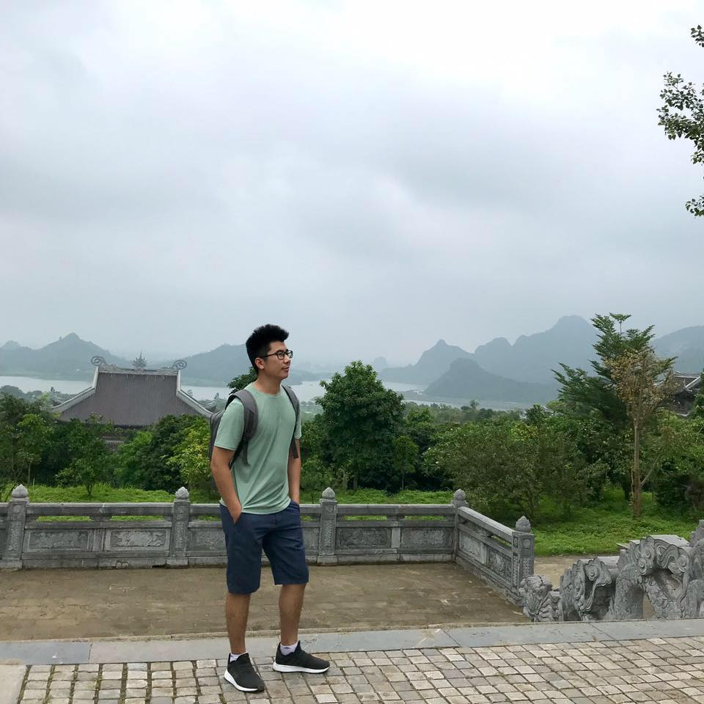
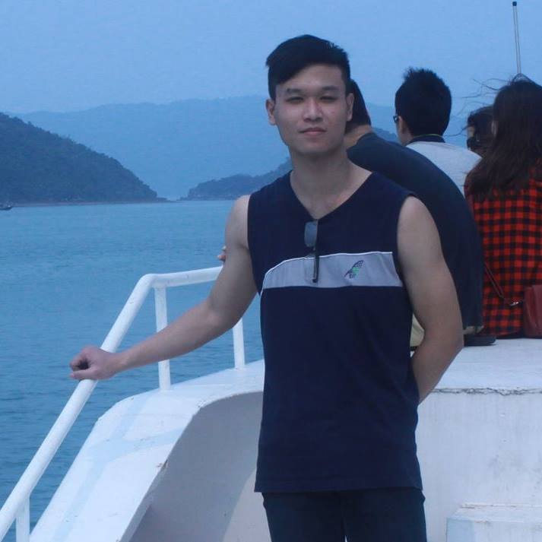
Supervisor: Mr. Dao Trong Duy
Tran Hoang Long
Team member
Pham Tung Duong
Team leader
Nguyen Gia Dang
Team member
Nguyen Duc Dung
Team member
Hoang Hai
Team member

Slide 3
Table of Contents
Project Overview
Project Management
Requirement Specification
Software Design
Testing

Slide 4
Project Overview

Slide 5
Background
The number of International visitors to Viet Nam .

Slide 6
Background
Viet Nam online traveling market size.

Slide 7
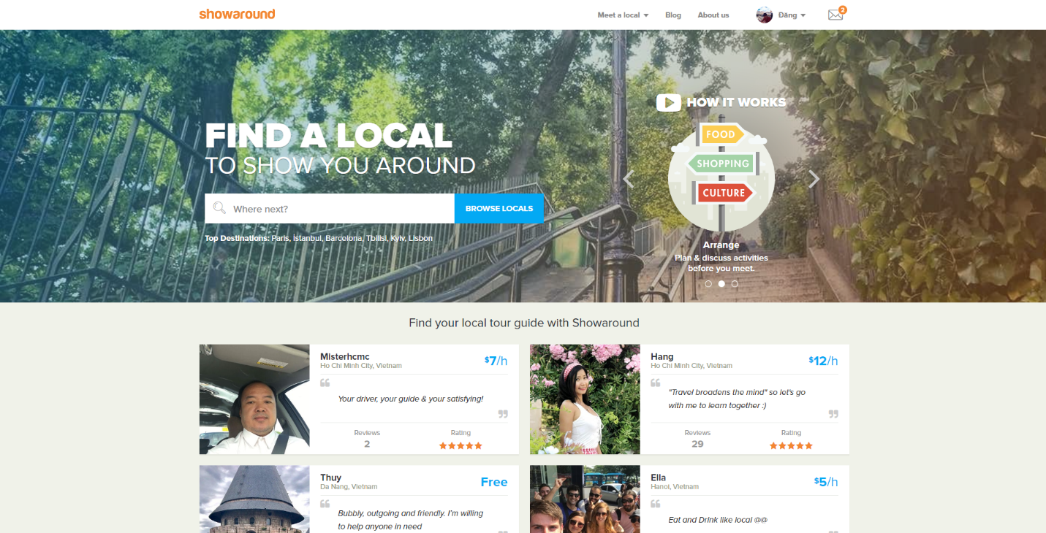
Existing Systems
Showaround.com
Advantages
Large network of guider, easy to become a guider.
Function and interface focus on guider.
Disadvantages
Not provide clear about what traveler would take.
Guider verification is not carefully in term of legal and identification.

Slide 8
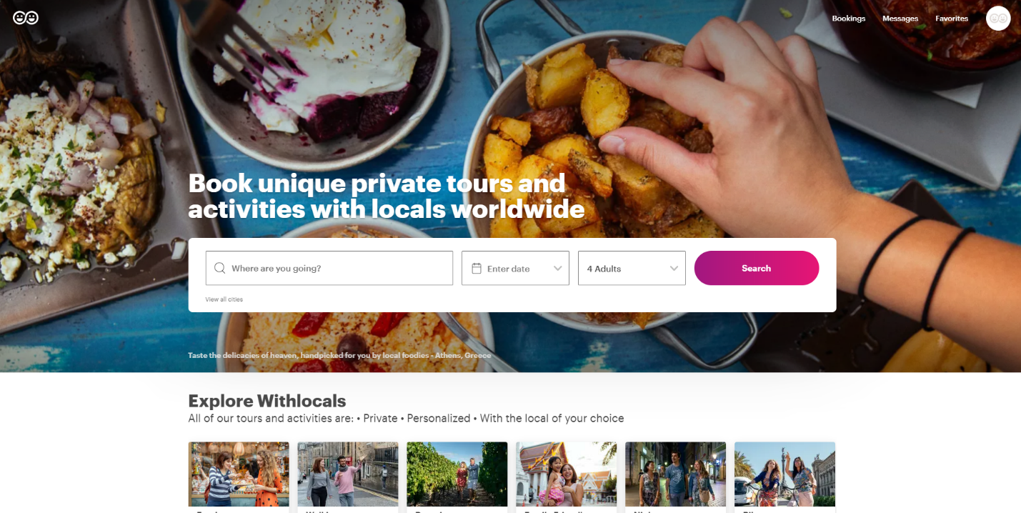
Existing Systems
Withlocals.com
Advantages
Trips are attached with guider, transparent information and process.
Be able to customize trip.
Mobile app supported.
Disadvantages
No direct contact with guiders before payment.
Not target on Viet Nam market.

Slide 9
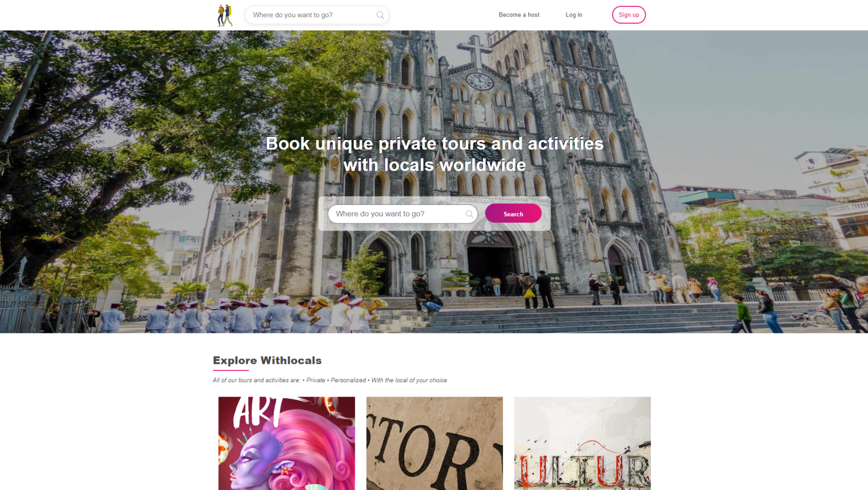
Proposed System
TWL website support travelers to find appropriate local guiders who they think would satisfy their exploration spirit . Travelers will easily find, communicate and find out whether a guider qualified as they like. It is important that Travelers can trust our verified Guiders. Specially, our Guides are recruited to serve foreign who travel in Viet Nam.

Slide 10





Main Features
Save
Review
Searching
Traveler
Booking

Slide 11


Main Features
Manage post
Guider
Manage trips

Slide 12

Out of Scope
Pay for guiders: TWL system does not take responsibility to make payment for guiders.

Slide 13
Project Managerment

Slide 14
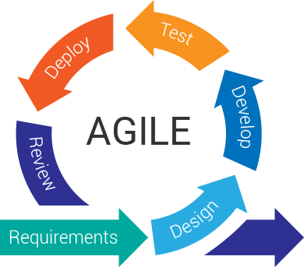
Software Development Process

Slide 15
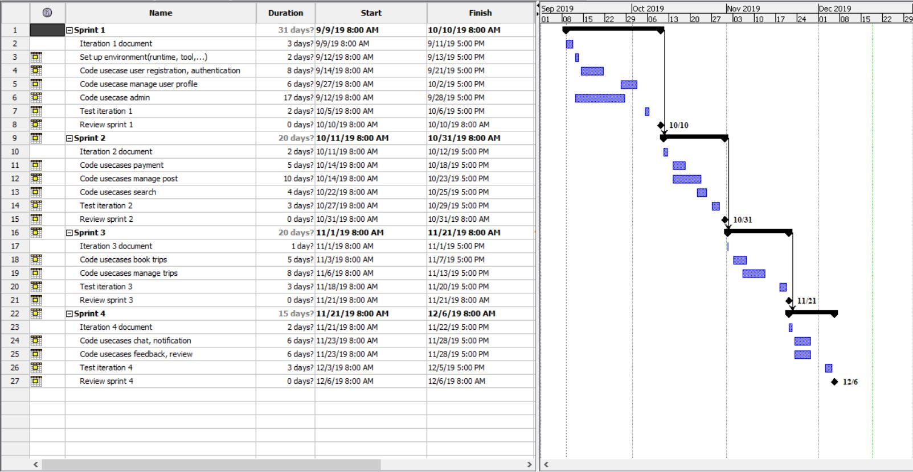
Task management
Gantt chart

Slide 16
Tools and Techniques
IDEs | Visual Studio Code, Intellij
Project management tools | Asana, ProjectLibre
Document tools | Microsoft Office
UML tools | Draw.io
Design tools | Figma.com
Testing tools | Postman, Swagger
Communication tools | Skype, Facebook, Phone
Deployment server | PostgreSql, MongoDB
Database management tools | pgAdmin4, MongoDB Compass
Source code version control | Github
File management tools | Google Drive

Slide 17


Communication Management
Work together: Every Tuesday and Thursday.
Communication:
Meeting with supervisor: Once a week

Slide 18
Risk Management
Risk register
No | Risk description | Category | Root cause | Avoidance plan | Impact
R1 | Poor defining scope, ambiguous definition | Scope | Poor business analysis | Team meeting, consult supervisor, investigate solution of similar system | High
R2 | Low motivation among team member | Organizational | Different motivation among member | Create team building activity | High
R3 | Have a technical block path or unfixable bug | Technical | Lacking experience of technical. | Consult supervisor, find alternative technology | High
R4 | Requirement changed while project is being processed | Scope | Different opinion between team member while implementing | Team meeting and consult supervisor to consider change. | High
R5 | Team member misunderstands requirement | Scope | Poor communicate process | discuss with BA, read requirement specification carefully | Low
R6 | Fail for estimating iteration time | Time | Lacking of predict work process | Working overtime to keep up work | Medium

Slide 19
Requirement Specification

Slide 20
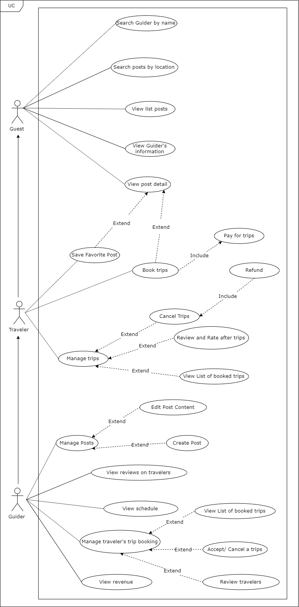


Use Case Diagram
Number of use cases: 41
Traveler: 19
Guest: 9
Guider:20
Admin: 10

Slide 21
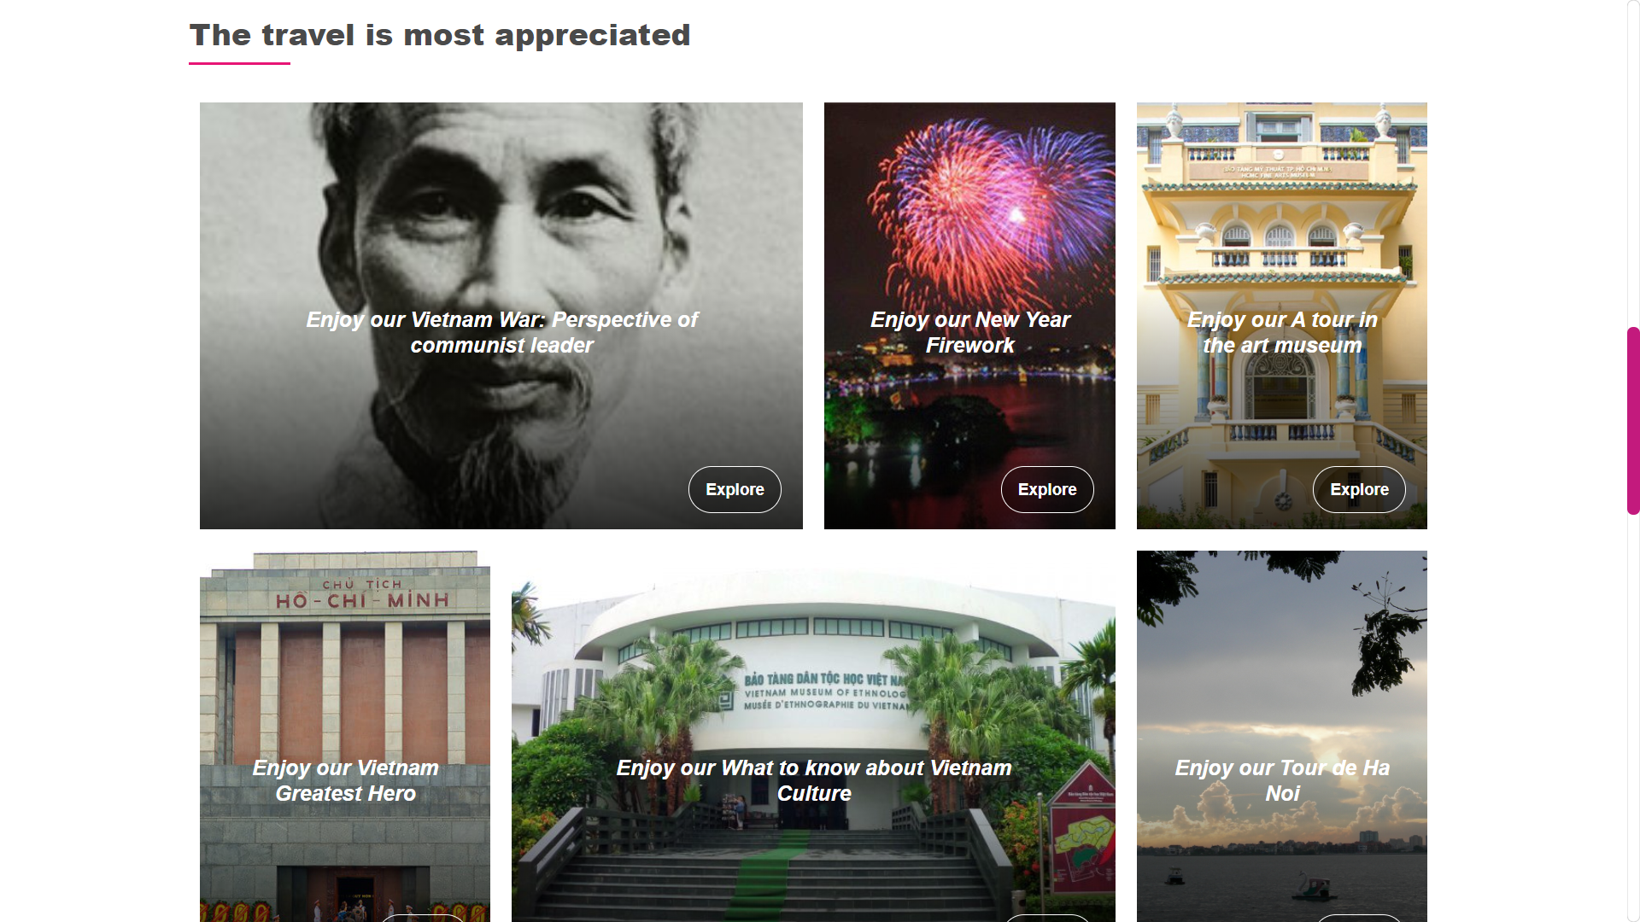
Function Requirements - Guest
Registration
Find Guiders
Find posts

Slide 22
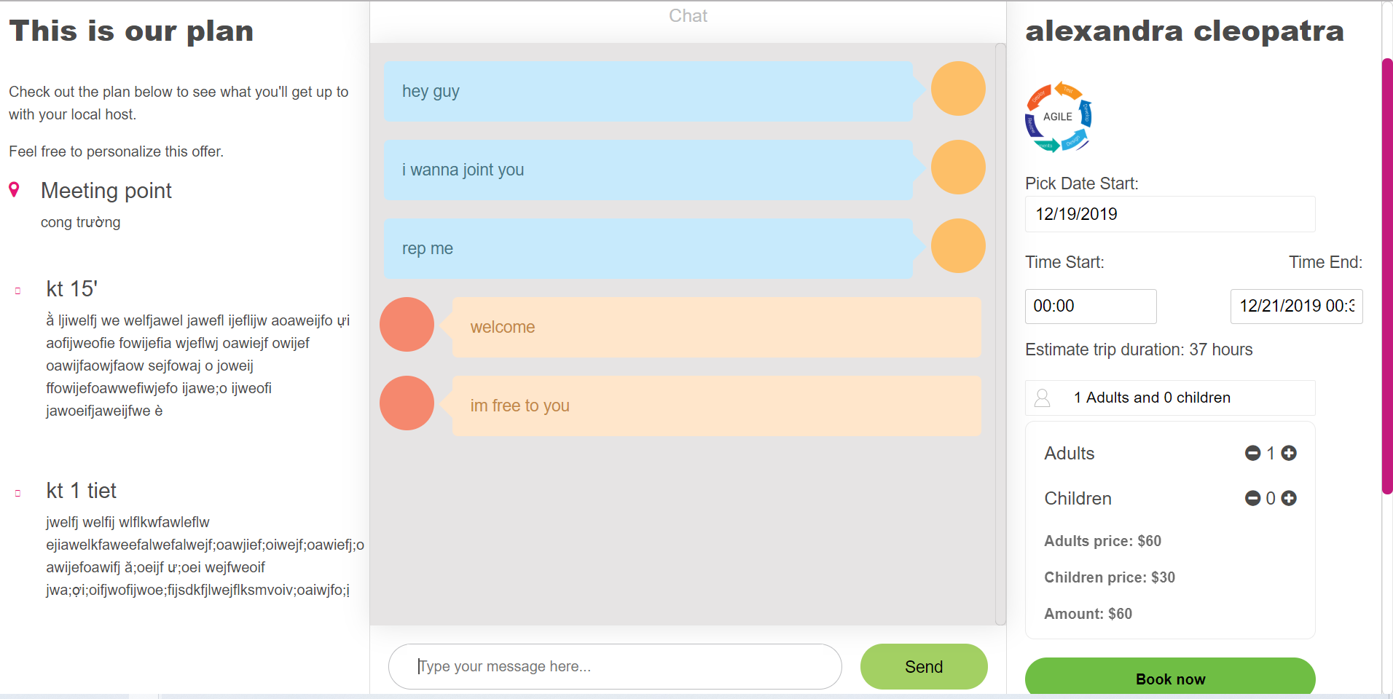
Function Requirements - Traveler
Communicate with Guider
Book trips
Manage their trips

Slide 23
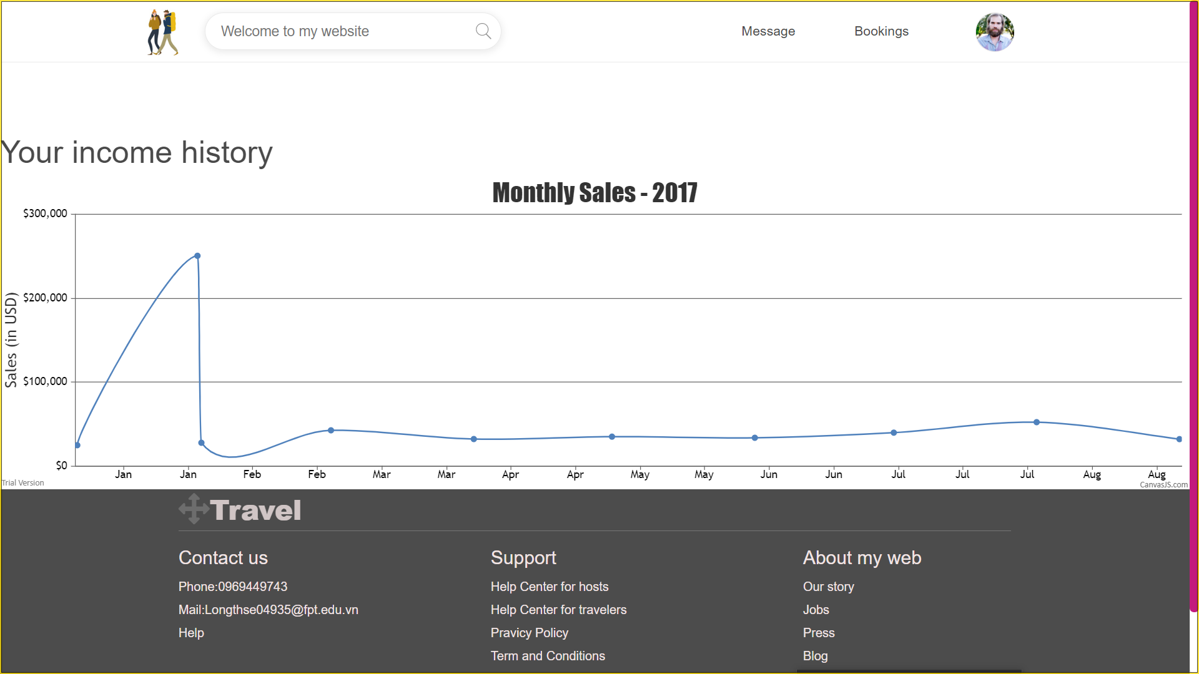
Function Requirements - Guider
Manage posts
Communicate with Travelers.
Manage trips.

Slide 24
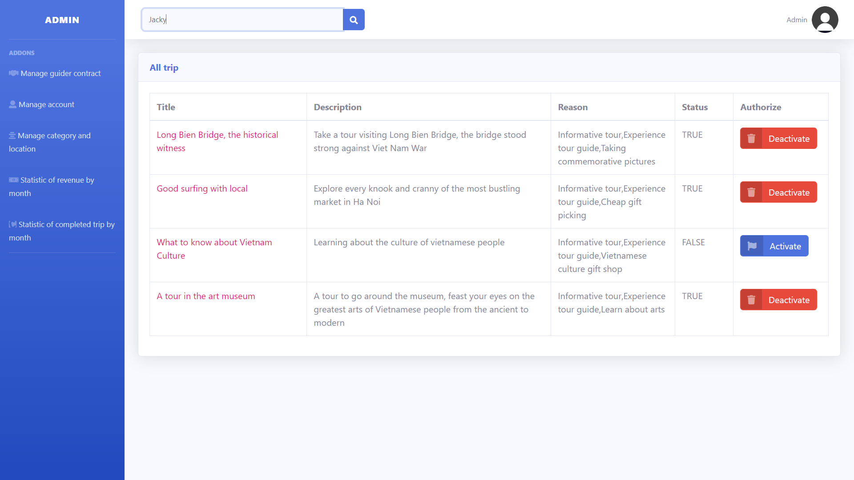
Function Requirements - Admin
Management account
View statistics

Slide 25


Non-Functional Requirements
TWL web interface is designed clearly, simply, monolithically and easy to get on.
All the texts and messages are informed friendly and clearly with instruction.
Usability
User account is secured by TWL system.
User password is encrypted.
Http request is secured by token.
Security

Slide 26


Non-Functional Requirements
The website should be available anytime users want to use it.
User can access everywhere from their computer with internet connection.
Availability
TWL website load time is expected to less than 10 seconds in standard network environment.
Response to user interact is expected to less than 5 seconds in standard network environment.
Performance

Slide 27

Non-Functional Requirements
The application use popular and reliable technology, that keep maintenance cost low.
The application can be easy to extend new functionality.
Maintainability

Slide 28
Software design

Slide 29
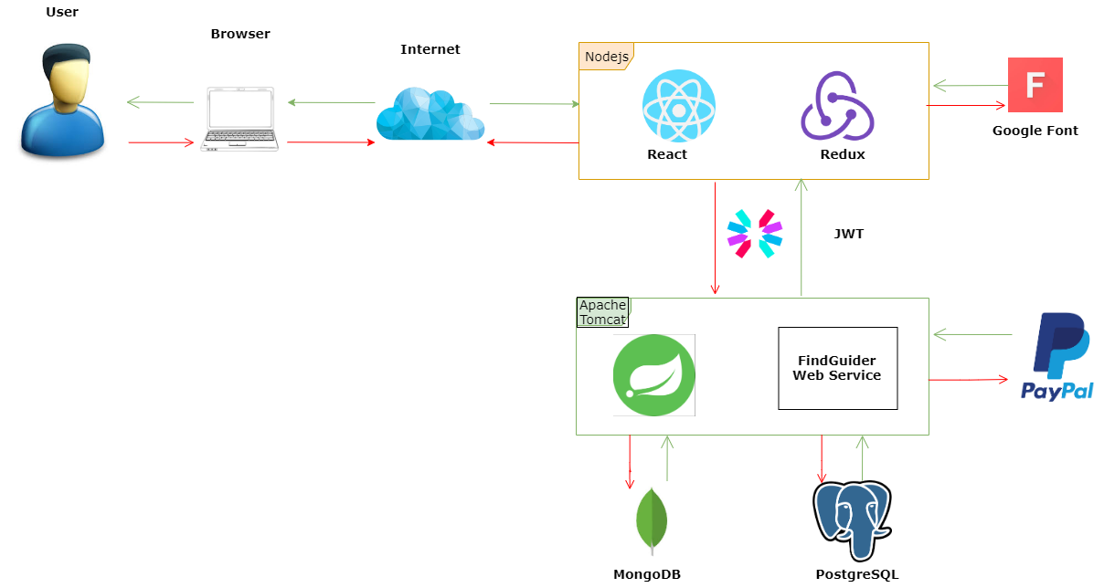
System Architecture

Slide 30
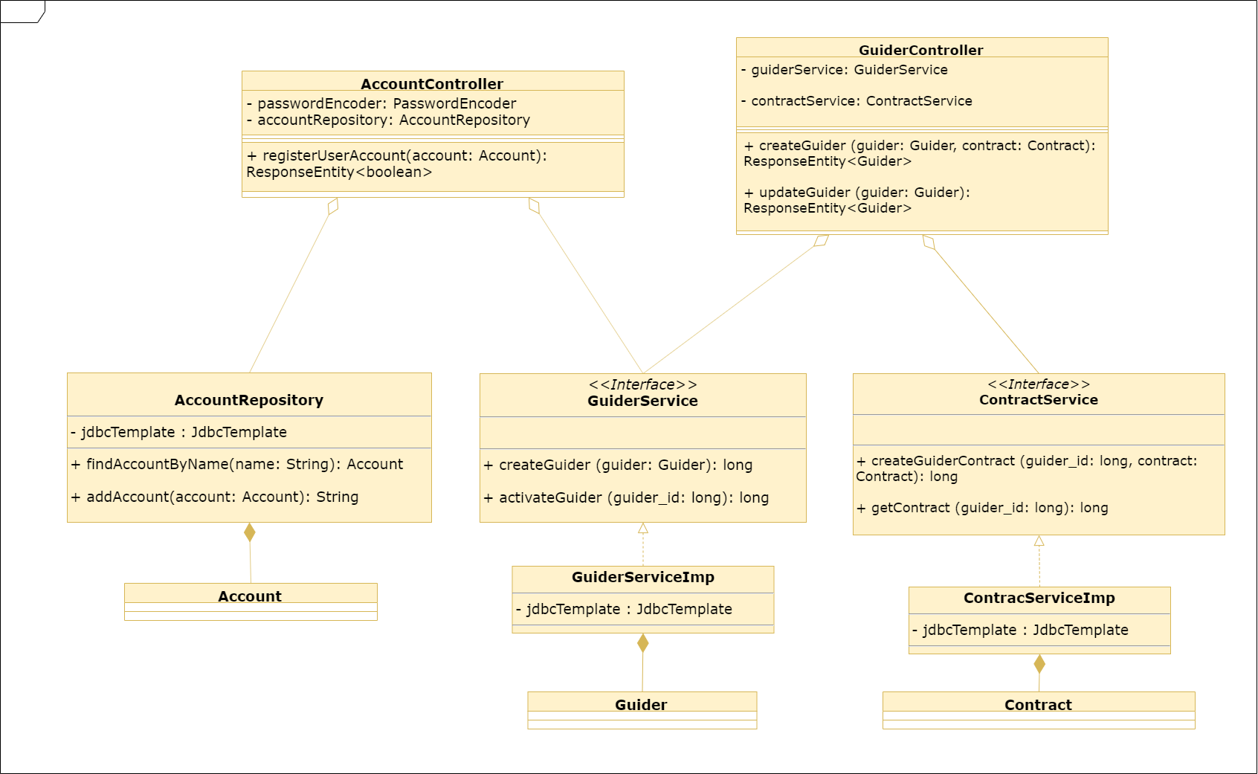
Class Diagram Example
Class diagram for “Sign up a guider account”

Slide 31
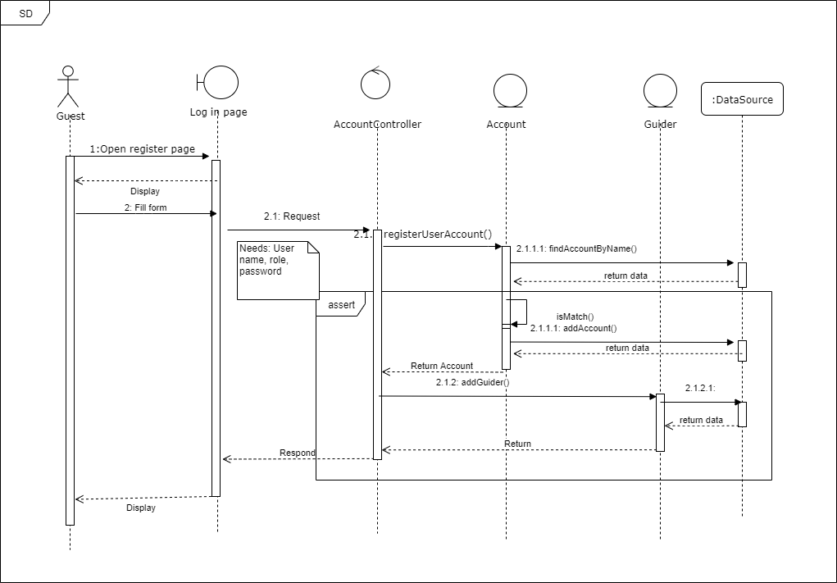
Sequence Diagram Example
Sequence Diagram for “Sign up a guider account”

Slide 32
Testing

Slide 33





Testing Tools
Google Sheet
(for log bug)
Android Studio
(for Unit test)
Microsoft Excel
(for write test report)
Google Chrome v68
Safari v11

Slide 34
Test Levels
Acceptance
Test
4 Level Tests
System Test
Integration Test
Unit Test

Slide 35
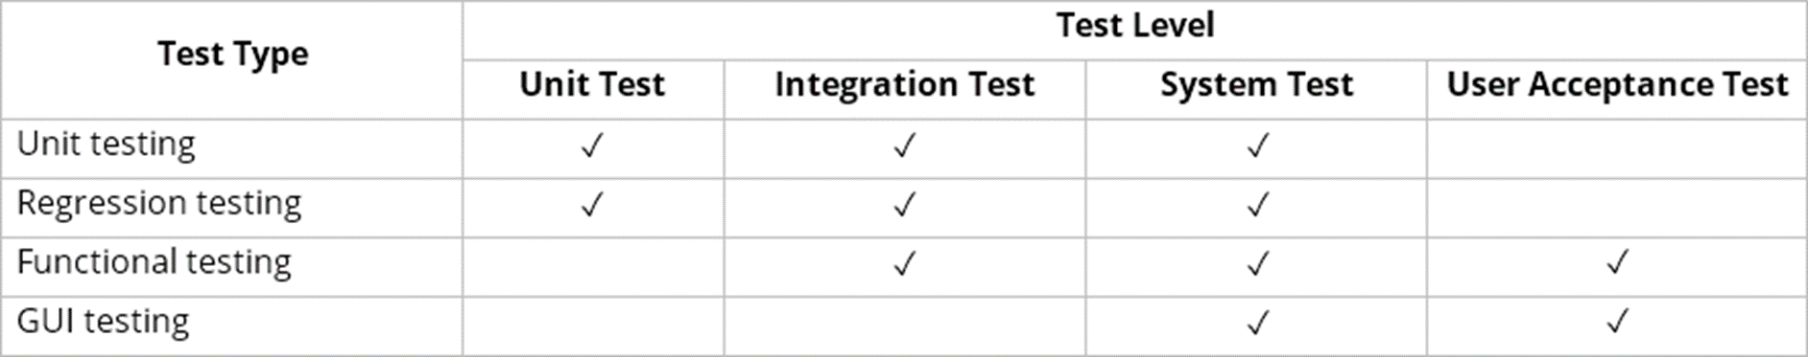
Test Types

Slide 36
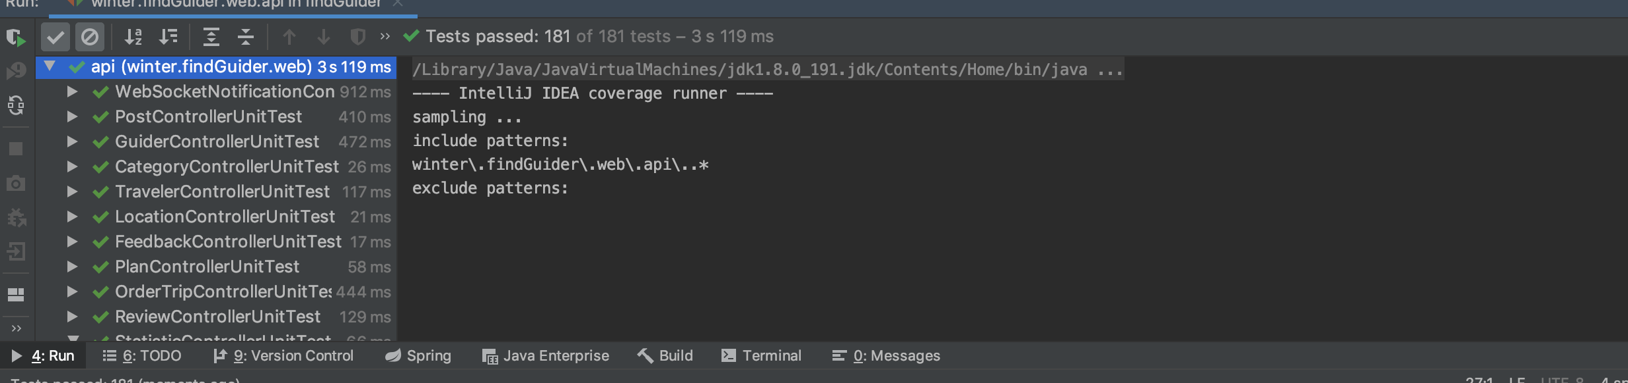
Unit Test
Number of Test Cases:
Controller : 181
Service : 153
Passed:
Controller : 181
Service : 153
Failed:
Controller : 0
Service: 0
Cover :
Controller: 99%
Service: 94%

Slide 37
Integration Tests
No | Module code | Pass | Fail | Untested | N/A | Number of test cases
1 | Guest | 83 | 0 | 0 | 0 | 83
2 | Admin | 96 | 0 | 0 | 0 | 96
3 | Guider | 182 | 0 | 0 | 0 | 182
4 | Traveler | 122 | 0 | 0 | 0 | 122
 | Sub total | 483 | 0 | 0 | 0 | 483
Test report

Slide 38
System Tests
No | Module code | Pass | Fail | Untested | N/A | Number of test cases
1 | Guest | 3 | 0 | 0 | 0 | 3
2 | Admin | 14 | 0 | 0 | 0 | 14
3 | Guider | 14 | 0 | 0 | 0 | 14
4 | Traveler | 8 | 0 | 0 | 0 | 8
 | Sub total | 39 | 0 | 0 | 0 | 39
Test report

Slide 39
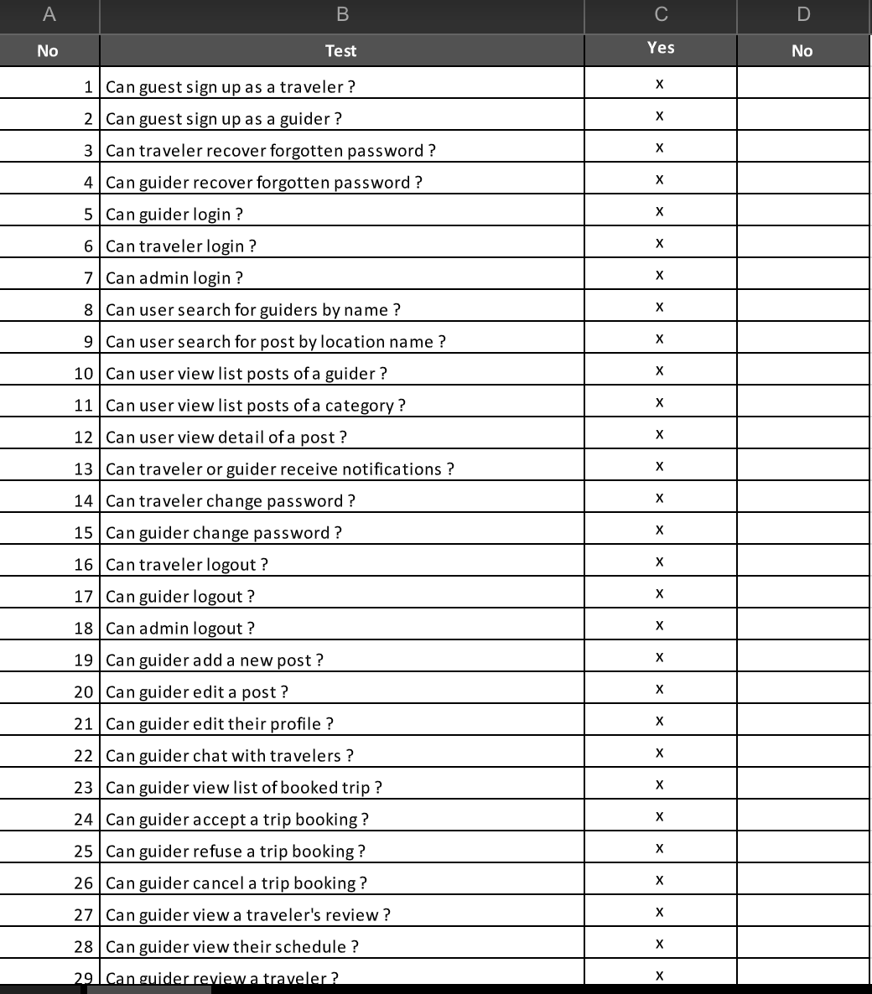
Acceptance Test

